Slide 1

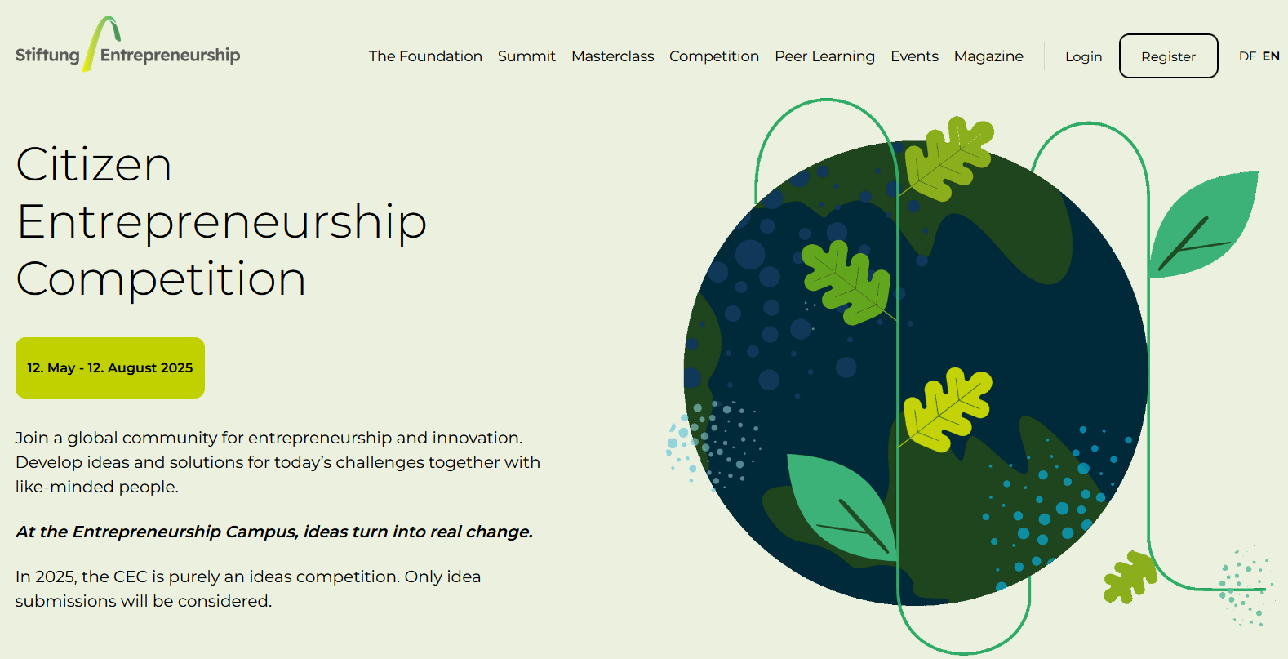


Citizen Entrepreneurship Competition
Program presentation
By Prof. Amal HASSAINE – KAZI TANI & Prof. Mahieddine BOUMENDJEL
Pays d’origine
Public cible
Site web
https://entrepreneurship.de/en/competition

Slide 2
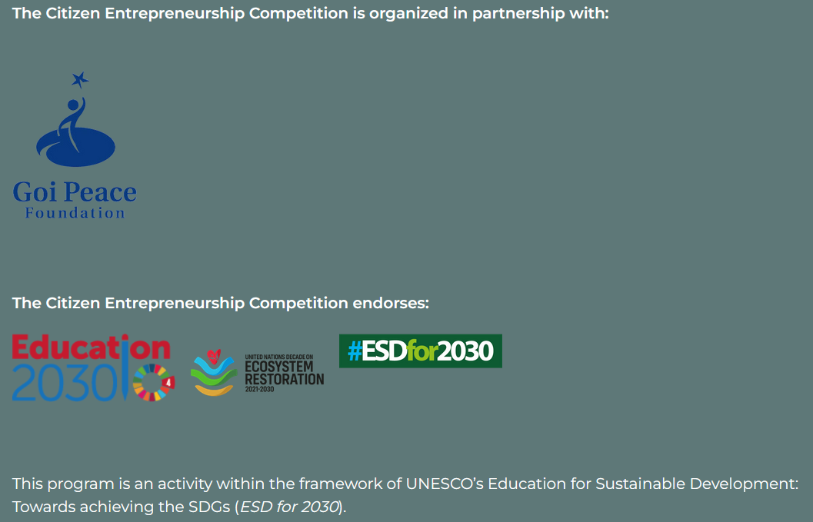
Overview
The Citizen Entrepreneurship Competition (CEC) was launched as part of the UNESCO Programme of Action on Education for Sustainable Development during the UNESCO Youth Summit 2013.
The Citizen Entrepreneurship Competition (CEC) aims to empower entrepreneurs – especially young ones – to work for a more peaceful and sustainable world.
Participants are invited to submit their ideas with social impact and to make a concrete commitment to one or more of the 17 UN Sustainable Development Goals (SDGs).
Entrepreneurs from 13 years old are invited to submit their idea to participate in the CEC.

Slide 3
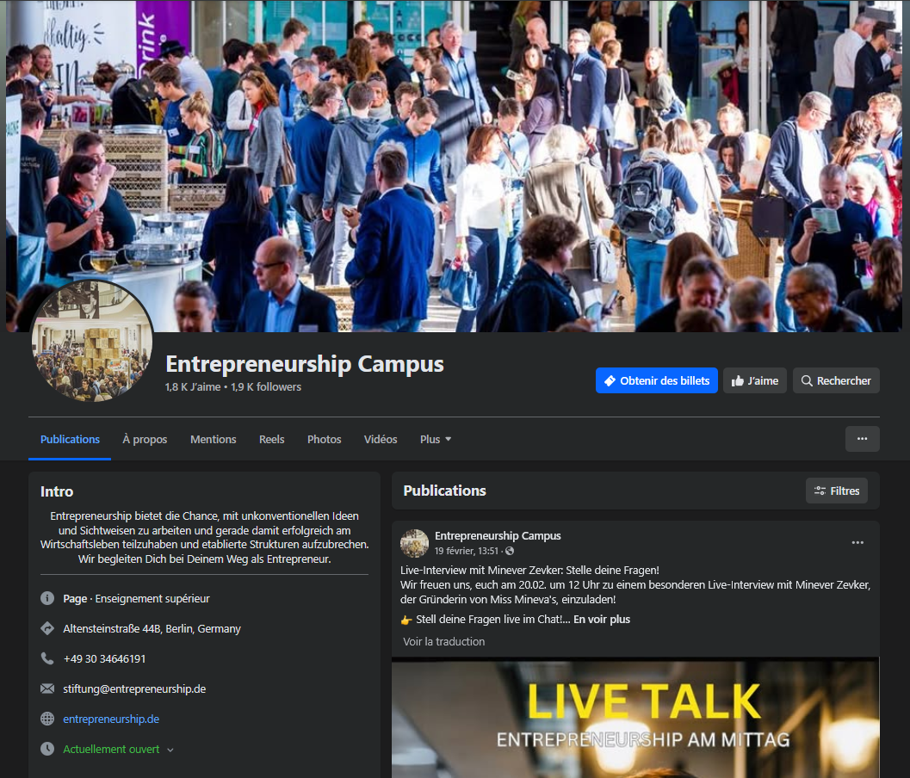
Objectives
Empower entrepreneurs around the world to find innovative responses to global and/or community challenges and to work towards a more peaceful and sustainable world,
Foster a "culture of entrepreneurship and creativity »,
Promote entrepreneurial education (free courses, literature, videos and audios are available ),
Offer the opportunity to exchange and network.
https://www.facebook.com/entrepreneurship.de/

Slide 4
Eligibility Criteria
Ideas have to address one or more of the 17 UN Sustainable Development Goals (SDGs)
Develop an innovative solution or proposal for a business. It may be in the conception, planning, or start-up phase, but must not yet have resulted in a start-up
Only submissions in English will be considered
Completion of both the "Brains versus Capital" and "Sustainable Entrepreneurship" courses, as well as a fully completed EDC (Entrepreneurial Design Canvas), are prerequisites for participation in the Voting Phase of the CEC.

Slide 5

17 UN Sustainable Development Goals (SDGs)

Slide 6
CEC Procedure
Registration
- Online registration and activation of the participant account
- Additional information required
Idea Submission and pre-selection
Final Evaluation
- Submission of a short pitch through the dashboard « My Idea/Project »
- Pre-selection phase (versus the competition criteria)
- If accepted, two months for further developing the idea
- Voting phase
- The top 10 ideas with the most votes will advance to the finals
- Ideas evaluated by the Stiftung Entrepreneurship expert jury

Slide 7
Award Criteria
🌿 Entrepreneurial vision
🍃 Feasibility
🌱 Innovation
🌍 Leadership
💚 Social impact
♻️ Sustainability

Slide 8
Recommandations
Fit with the CEC objectives, priorities and requirements
Submission of an « idea » and not a « project »
Develop an innovative solution or proposal for a business that addresses the SDGs
Images and videos (max. 3 minutes) are great ways to visually present an idea or project and increase the chances of getting votes.
Check the rights for what is uploaded. Free images can be found on Unsplash and Pixabay
Consult the FAQs on the Stiftung Entrepreneurship website before any soumission : https://entrepreneurship.de/en/faq#cecfaq

Slide 9
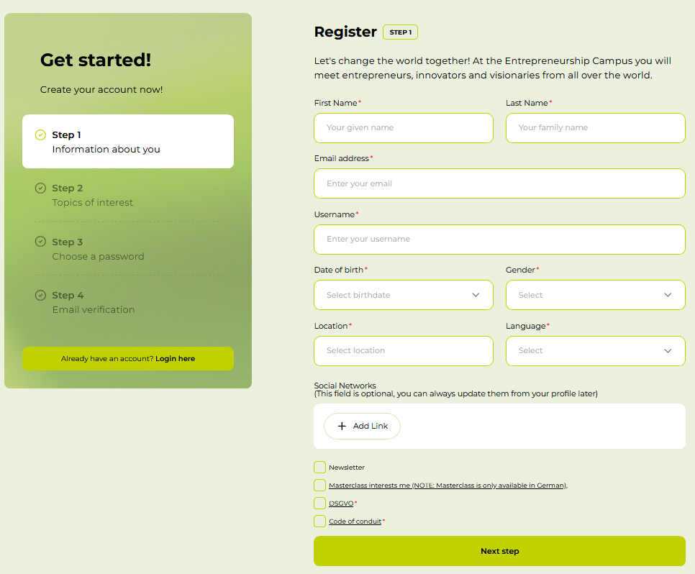
Timeline
Start of the CEC and the registration process:
May 12, 2025
Idea Submission and pre-selection:
May 12 – July 10, 2025
Vote phase :
July 11 – August 12, 2025
Final evaluation:
August 2025

Slide 10
Useful links
https://entrepreneurship.de/en/stiftung-entrepreneurship
https://entrepreneurship.de/en/competition
https://entrepreneurship.de/en/competition-procedure
https://entrepreneurship.de/en/competition-judges
https://entrepreneurship.de/en/masterclass-grundungen
References
https://social.desa.un.org/issues/disability/sustainable-development-goals-sdgs-and-disability
https://entrepreneurship.de/en/competition
https://sdgs.un.org/ar
https://pixabay.com/fr/photos/merci-langues-international-5965171/

